Slide 1
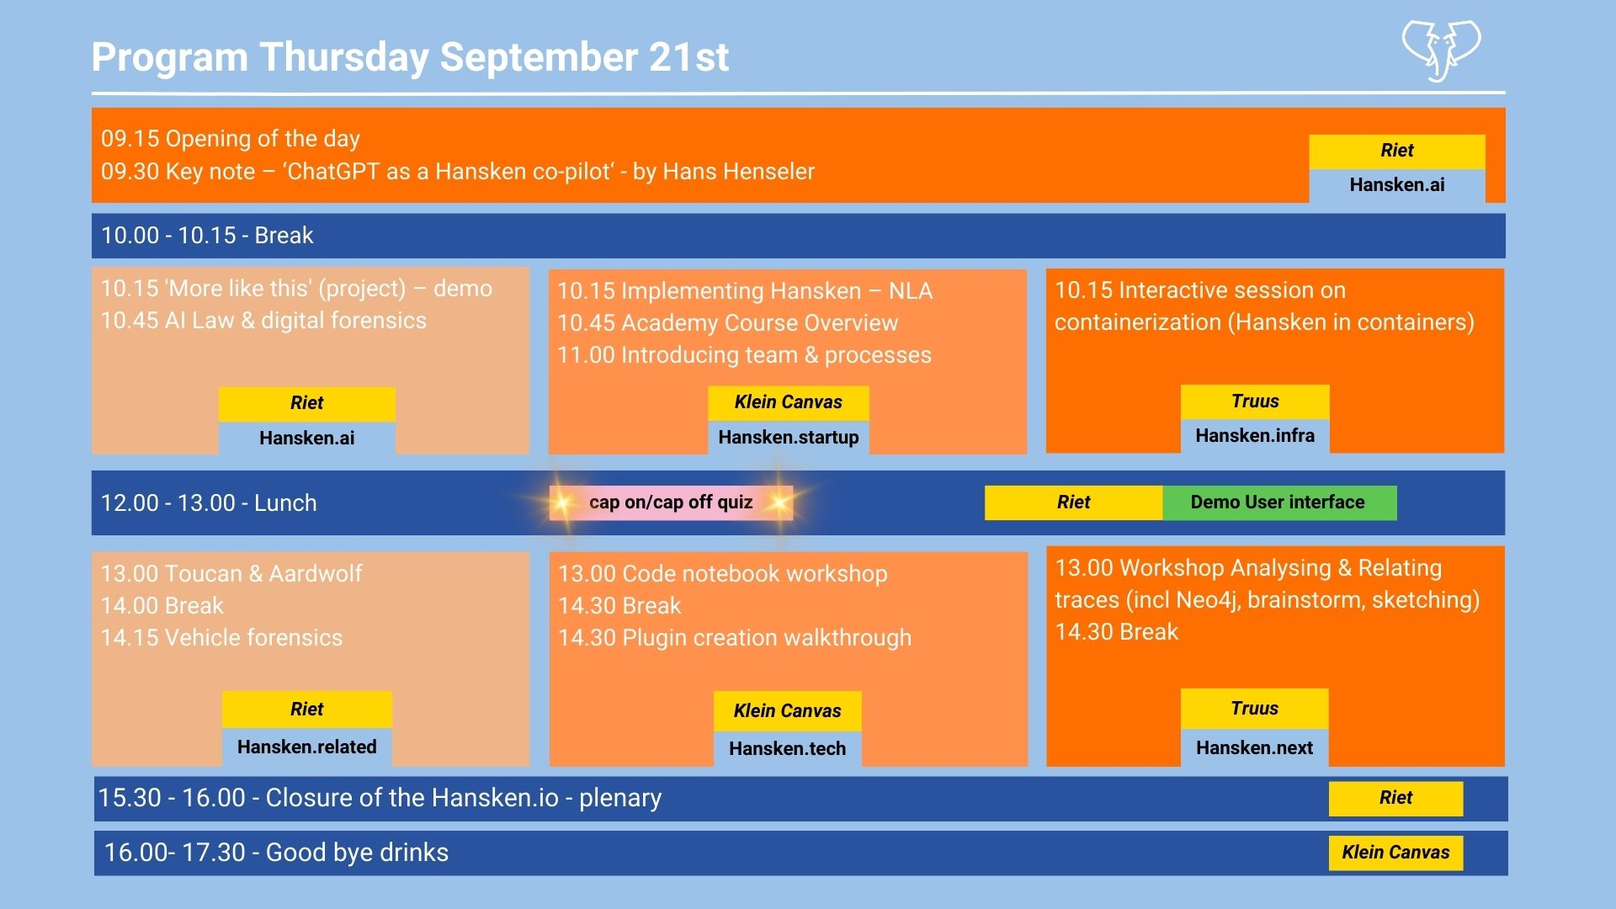

Slide 3
Hansken code notebooks and extraction plugins
Hansken.IO, 21 september 2023, Amsterdam
Job Remco Hans
Netherlands Forensic Institute

Slide 4
Hansken extraction plugins
Walkthrough

Slide 5
Introduction
👨‍🏫 My nickname: remco-nfi
🐘 I am part of the Hansken development team
👨‍🚀 One of the main code contributors to the Extraction Plugin SDK
👨‍🔧 I am a software engineer
⚠️ not a
doctor
case investigator
authority on digital forensics
…

Slide 6
Talking points for today
(3 min) Our fictional case…
(3 min) Extraction plugin concepts
(5 min) Extraction plugin template
(5 min) Create logic: Parse data and transform to Hansken types
(5 min) Link logic to plugin
(5 min) Run with Hansken.py
(3 min) Add tests to our code
(5 min) Run the plugin during an extraction
(3 Min) Wrap up and questions

Slide 7
Talking points for today
(3 min) Our fictional case…
(3 min) Extraction plugin concepts
(5 min) Extraction plugin template
(5 min) Create logic: Parse data and transform to Hansken types
(5 min) Link logic to plugin
(5 min) Run with Hansken.py
(3 min) Add tests to our code
(5 min) Run the plugin during an extraction
(3 Min) Wrap up and questions

Slide 8
Our fictional case
🕵️ We are investigating a case
🕒 Our suspect mentions that zie was not at home and not using zir phone. Is that True?
📱 Evidence item: iPhone 15
Imaginary & creative solution:
🔌Find out when the phone is charging, and at what rate?
🔋 Find out when is the phone discharging, how fast is the phone discharging?
📈 Can we use the charging/discharging rate to prove our hypothesis?
So…
How can we know this?
And if we know this, how can we add this knowledge to Hansken?

Slide 9
Our fictional case
Background research: knowledgeC.db
https://www.doubleblak.com/m/blogPosts.php?id=2
http://www.mac4n6.com/blog/2018/8/5/knowledge-is-power-using-the-knowledgecdb-database-on-macos-and-ios-to-determine-precise-user-and-application-usage
For this walkthrough: we will only focus on battery events!
KnowledgeC.db is a SQLite file on recent iOS versions that tracks lots of different activity on the device ranging from Battery Level and Bluetooth connections to which speaker is in use and what it is playing at any given time (…) The database is located at /private/var/mobile/Library/CoreDuet/Knowledge/knowledgeC.db and is made up of 12 tables.

Slide 10
Talking points for today
(3 min) Our fictional case…
(3 min) Extraction plugin concepts
(5 min) Extraction plugin template
(5 min) Create logic: Parse data and transform to Hansken types
(5 min) Link logic to plugin
(5 min) Run with Hansken.py
(3 min) Add tests to our code
(5 min) Run the plugin during an extraction
(3 Min) Wrap up and questions

Slide 11
Extraction plugin concepts
Hansken.py
Uses Hanskens REST API *
Analysis of multiple traces *
Visualizations *
Can add data to Hansken* Manually repeatable *
Extraction Plugins
* Runs inside Hansken during an extraction
* Great for processing a lot of traces
* Great for adding (a lot) of extracted data or child traces * Automatically repeatable
* Full chain of evidence preserved
* Run in total isolation (no network & root)
* Follows the syntax of Hansken.py
Extraction Plugins can run as Hansken.py scripts

Slide 12
Extraction plugin concepts
Extraction plugin Software Development Kit (SDK):
Java API and tooling, to be able to write an extraction plugin with the Java programming language
Python API and tooling, to be able to write an extraction plugin with Python programming language
Test framework, to be able to test extraction plugins before they are used production
Documentation
Examples (Github)
Community: Extraction plugins made by the community on Gitlab

Slide 13

Remainder: hands on
guided by this slidedeck
Image by rawpixel.com on Freepik

Slide 14
Talking points for today
(3 min) Our fictional case…
(3 min) Extraction plugin concepts
(5 min) Extraction plugin template
(5 min) Create logic: Parse data and transform to Hansken types
(5 min) Link logic to plugin
(5 min) Run with Hansken.py
(3 min) Add tests to our code
(5 min) Run the plugin during an extraction
(3 Min) Wrap up and questions

Slide 15
Extraction plugin template
Steps
Clone an template (empty) plugin from Github
Build the template plugin
Publish the plugin
Refresh the plugin list in Hansken

Slide 16
Talking points for today
(3 min) Our fictional case…
(3 min) Extraction plugin concepts
(5 min) Extraction plugin template
(5 min) Create logic: Parse data and transform to Hansken types
(5 min) Link logic to plugin
(5 min) Run with Hansken.py
(3 min) Add tests to our code
(5 min) Run the plugin during an extraction
(3 Min) Wrap up and questions

Slide 17
Create logic: Parse data and transform to Hansken types
Steps
Determine how to store battery events in Hansken (trace model)
Transform database to battery events (SQLite query)
Add method to plugin

Slide 18
Talking points for today
(3 min) Our fictional case…
(3 min) Extraction plugin concepts
(5 min) Extraction plugin template
(5 min) Create logic: Parse data and transform to Hansken types
(5 min) Link logic to plugin
(5 min) Run with Hansken.py
(3 min) Add tests to our code
(5 min) Run the plugin during an extraction
(3 Min) Wrap up and questions

Slide 19
Link logic to plugin
Steps
Plugin structure
Update plugin info
Naming convention
Matcher (common PITA)
Plugin resources (common PITA2)
Implement process method

Slide 20
Talking points for today
(3 min) Our fictional case…
(3 min) Extraction plugin concepts
(5 min) Extraction plugin template
(5 min) Create logic: Parse data and transform to Hansken types
(5 min) Link logic to plugin
(5 min) Run plugin with Hansken.py
(3 min) Add tests to our code
(5 min) Run the plugin during an extraction
(3 Min) Wrap up and questions

Slide 21
Run plugin with Hansken.py
Steps
Upload test data to Hansken (single file)
Run plugin from the IDE
Determine program arguments
Define run profile
Run!
Verify results

Slide 22
Talking points for today
(3 min) Our fictional case…
(3 min) Extraction plugin concepts
(5 min) Extraction plugin template
(5 min) Create logic: Parse data and transform to Hansken types
(5 min) Link logic to plugin
(5 min) Run with Hansken.py
(3 min) Add tests to our code
(5 min) Run the plugin during an extraction
(3 Min) Wrap up and questions

Slide 23
Add tests to our code
Steps
Why?
Have a look at the documentation
Add test data to plugin
Generate & verify baseline resuts

Slide 24
Talking points for today
(3 min) Our fictional case…
(3 min) Extraction plugin concepts
(5 min) Extraction plugin template
(5 min) Create logic: Parse data and transform to Hansken types
(5 min) Link logic to plugin
(5 min) Demo: run with Hansken.py
(3 min) Add tests to our code
(5 min) Run the plugin during an extraction
(3 Min) Wrap up and questions

Slide 25
Run the plugin during an extraction
Steps
Package the plugin (tox –e package)
Refresh plugin list in Hansken
Run an extraction
Inspect results
Inspect chain of evidence
BONUS: Plugin-card

Slide 26
Talking points for today
(3 min) Our fictional case…
(3 min) Extraction plugin concepts
(5 min) Extraction plugin template
(5 min) Create logic: Parse data and transform to Hansken types
(5 min) Link logic to plugin
(5 min) Demo: run with Hansken.py
(3 min) Add tests to our code
(5 min) Run the plugin during an extraction
(3 Min) Wrap up and questions

Slide 27
Wrap up
We learned:
What extractions plugins are, how they relate to Hansken.py use cases
Where to find plugins created by other community members
How to create, test, and run a new plugin by downloading a plugin template and add an actual implementation
Extraction plugins in practice
Starting to prove itself in action
Technology preview please report bugs, and share your experience!
Debugging can be difficult -> “why does my plugin not work”?
Needs to grow!

Slide 28

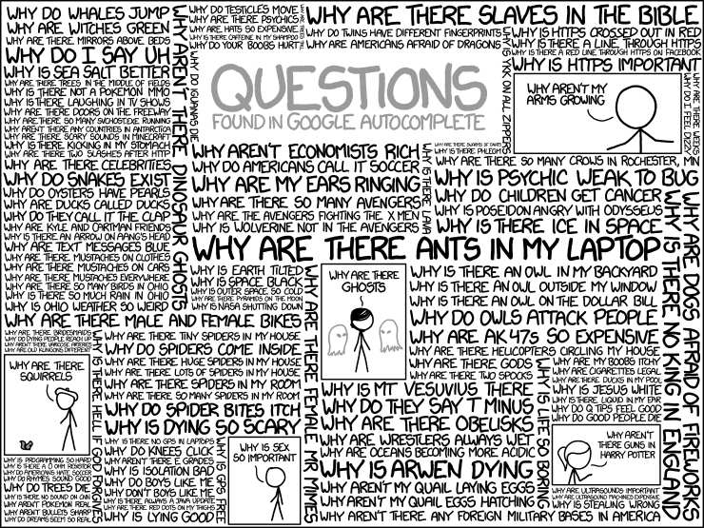
Thank you for your attention

Slide 29
Thank you for your attention

